Slide 1

Application: Health App Type: Application Architecture View: Logical View Style: Layered Architecture Pattern
Users
Delivery Channels
Core Business Processes
Data And Information
Technology Enablers
Track Diet
User Details
Payment Gateways
Coach
Track Fitness
Users Exercise Input
Mobile App Dev Platforms
Mobile App
Get Reports
User Diet Input
Fitness
Enthusiastic
View Marketplace
Consultant Details
Diet Information API
Manage Subscriptions
Fitness Plan
Exercise Information API
Feedback
Diet Plan
Cloud Services (AWS )
Web Browser
View Diet Plan
Payment Information
Github & Delivery Pipeline
Administrator
View Fitness Plan
Feedback

Slide 2
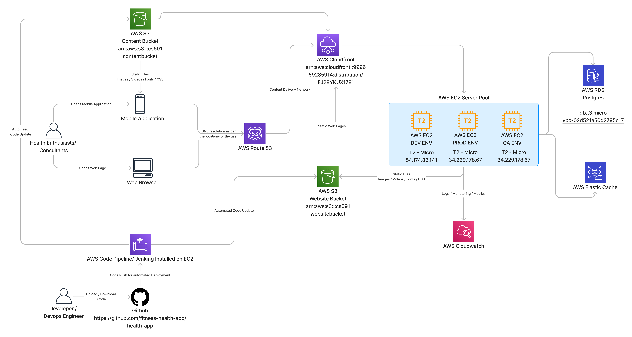
Application: Health App Type: Application Architecture View: Process View Style: Client-Server Pattern

